Slide 1
hotel management
System
Kristen Thomas

Slide 2
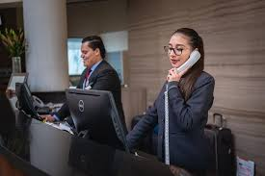
Problem statement Pt. 1
Hotel management systems are utilized by most hotels around the world to handle the large volume of guests, rooms, and other information they must handle securely.
Since hotels are the most utilized accommodations when traveling, it is important that they can accurately store all the guests personal and booking information and streamline this process.

Slide 3
Problem statement pt. 2
Creating a kiosk or app where guests can access their information and check in or check out will allow for an expedited process when staying or leaving a hotel.
Guests can review their reservation information or hotel information easily through a lobby kiosk.

Slide 4
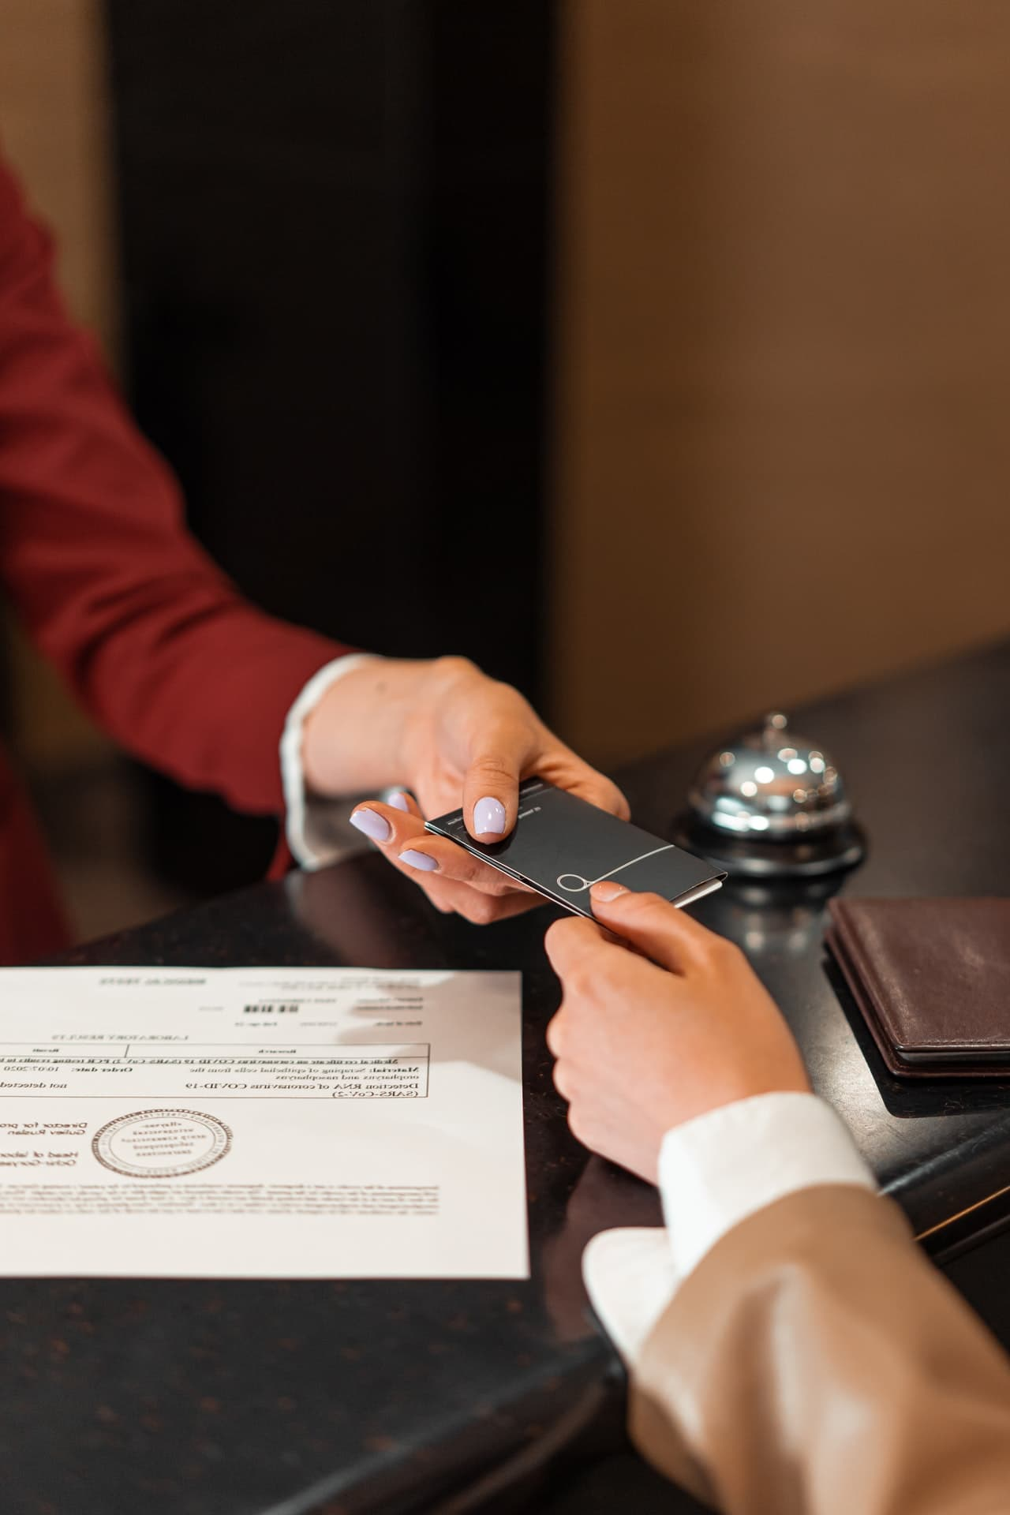
Target users
Guests- expedited check in and check out, limited interaction with staff
Benefit for business travelers, introverts, and late-night arrivals
Self-check-in method to help with long lines
Hotel staff- lighten the load on employees so they can focus on more personalized issues with hotel guests
Management- can view insights from guest arrivals and prioritize other management responsibilities

Slide 5

Demo- Updated Midterm
This demo will demonstrate UI enhancements made to the following elements from the midterm demo:
Guests finding a reservation- providing relevant information to their booking to view their hotel room information
Guest Check In- providing information and valid ID number to check into their hotel room(s)
Express Check-Out- Providing information to quickly check out of a hotel room
Hotel Overview- General information about the hotel and its amenities

Slide 6
Demo- Added features and final product
This demo will also demonstrate additional features:
Management Mode- A dashboard including Create/Edit a Reservation, Manage the Kiosk, and Search for bookings
Log In/Out- Management must enter the correct pin to access sensitive guest information
Create/Edit Reservations- Managers can change guest information in a selected booking
Search for bookings- Managers can search any relevant information to view a booking
SQL database- code is upgraded to read from the MySQL database rather than an XML file

Slide 7

testing
Importance
Unit and Integration testing is vital so that hotels can maintain the integrity of guest information when they are checking in or out of the hotel.
It prevents extra charges, costly bugs, and other issues that may arise from a poorly working system.

Slide 8
testing
Testing Strategy
Unit testing- test each individual guest function
Integration testing- ensure that all units are interacting with each other correctly
System testing- test the entire system and database with real world scenarios

Slide 9
Thank you

